Slide 1
Artificial intelligence
Project SUBMISSION phase 3

Slide 2
Market Basket Analysis
INTRO :
  Address challenges like handling large datasets, ensuring data privacy, and interpreting complex association rules. Discuss considerations such as choosing appropriate algorithms and tools based on the size and nature of the dataset.
  Briefly explain the process of data collection, emphasizing the importance of clean and relevant transaction data.
  Discuss data preprocessing techniques, including data cleaning and transformation, to prepare the data for analysis.

Slide 3
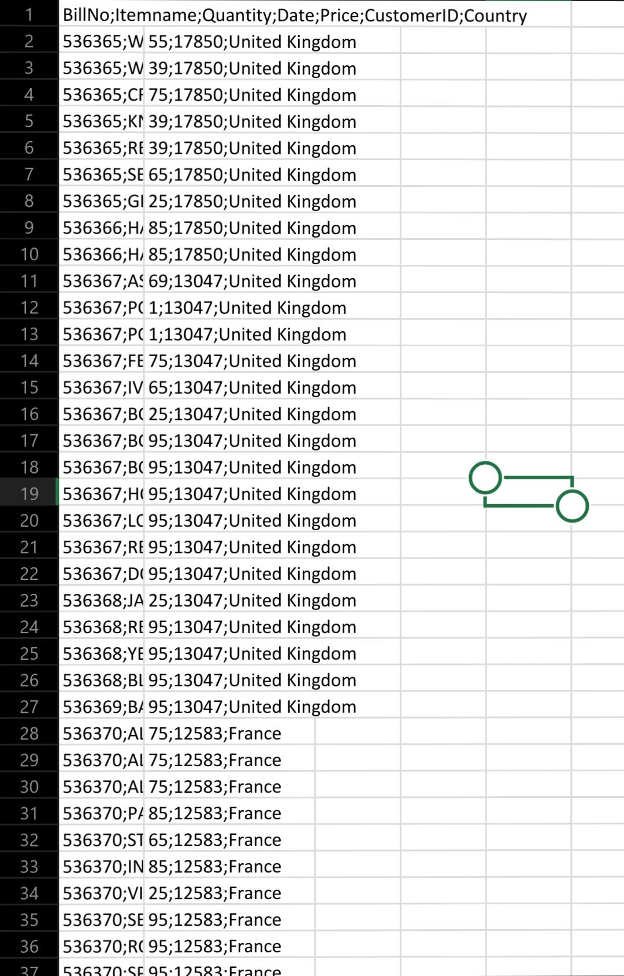
DATA SET :

Slide 4
CODE :
dataframe[variable].quantile(0.01) quartile3 = dataframe[variable].quantile(0.99) interquantile_range = quartile3 - quartile1 up_limit = quartile3 + 1.5 * interquantile_range low_limit = quartile1 - 1.5 * interquantile_range return low_limit, up_limit def replace_with_thresholds(dataframe, variable): low_limit, up_limit = outlier_thresholds(dataframe, variable)
import pandas as pd from mlxtend.frequent_patterns import apriori, association_rules pd.set_option('display.max_columns', None) pd.set_option('display.max_rows', None) pd.set_option('display.width', 500) df = pd.read_excel("/kaggle/input/market-basket-analysis/Assignment-1_Data.xlsx") def outlier_thresholds(dataframe, variable): quartile1 = dataframe[variable].quantile(0.01) quartile3 = dataframe[variable].quantile(0.99)

Slide 5
CODE :
interquantile_range = quartile3 - quartile1 up_limit = quartile3 + 1.5 * interquantile_range low_limit = quartile1 - 1.5 * interquantile_range return low_limit, up_limit def replace_with_thresholds(dataframe, variable): low_limit, up_limit = outlier_thresholds(dataframe, variable) dataframe.loc[(dataframe[variable] < low_limit), variable] = low_limit dataframe.loc[(dataframe[variable] > up_limit), variable] = up_limit def retail_data_prep(dataframe): dataframe = dataframe[dataframe["Quantity"] > 0] dataframe = dataframe[dataframe["Price"] > 0] replace_with_thresholds(dataframe, "Quantity") replace_with_thresholds(dataframe, "Price") return dataframe df = retail_data_prep(df) df.describe().T

